Slide 1
Chapter 2
Finite Automata

Slide 2
Outline
Introduction to Finite Automata
Deterministic Finite Automata
Nondeterministic Finite Automata

Slide 3
Finite Automaton (FA)
Recognizer for “Regular Languages”
Informally, a state diagram that comprehensively captures all possible states and transitions that a machine can take while responding to a stream or sequence of input symbols

Slide 4
e-commerce : an application to FA
Protocol for e-commerce using e-money
Allowed events:
The customer can pay the store (send the money-file to the store)
The customer can cancel the money (like putting a stop on a check)
The store can ship the goods to the customer
The store can redeem the money (cash the check)
The bank can transfer the money to the store

Slide 5
e-commerce : an application to FA
The protocol for each participant:
Start
a
pay
b
redeem
d
transfer
f
Ship
Ship
Ship
c
redeem
e
transfer
g
(a) Store

Slide 6
e-commerce : an application to FA
The protocol for each participant:
2
Cancel
pay
Cancel
1
3
4
redeem
transfer
Start
Start
(b) Customer
(c) Bank

Slide 7
e-commerce : an application to FA
Completed protocols:
cancel
Pay, cancel
Pay, cancel
Pay, cancel
Start
a
pay
b
redeem
d
transfer
f
Ship
Ship
Ship
c
redeem
e
transfer
g
Pay, cancel
Pay, cancel
Pay, cancel
(a) Store

Slide 8
e-commerce : an application to FA
Completed protocols:

Slide 9
C
p, S
P,C
P,C
P,C
Start
P
R
T
2
a
b
d
f
P,C,R,S
P,C,R,S
S
S
S
R
T
C
c
e
g
1
3
4
p, S
R
T
P,C
P,C
P,C
(a) Store
Start
(c) Bank
Start
a b c d e f g
p
p
1
2
3
4
P
S
C
C
C
Product Automation to validate protocol
P
S
R
p
p
R
R
P,C
P
S
S
C
P,C
P,C
P,C
R

Slide 10
e-commerce : an application to FA
The entire system as an Automaton:

Slide 11
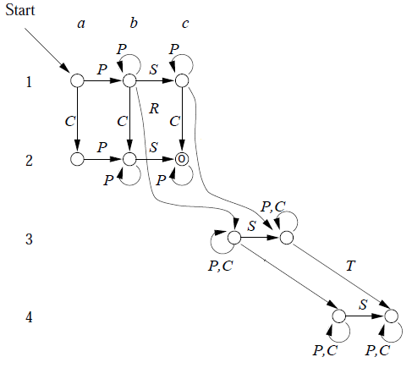
e-commerce : an application to FA
The entire system as an Automaton:

Slide 12
Outline
Introduction to Finite Automata
Deterministic Finite Automata
Nondeterministic Finite Automata

Slide 13
Finite Automaton (FA)
Deterministic Finite Automata (DFA)
The machine can exist in only one state at any given time
Non-deterministic Finite Automata (NFA)
The machine can exist in multiple states at the same time

